Slide 1


Foundations of Biostatistics IV
DEPH 312 Principles of Scientific Evidence
Talal Alshihayb ^{BDS, DScD}
Diplomate, American Board of Dental Public Health
Assistant Professor
Department of Preventive Dental Science, College of Dentistry, King Saud bin Abdulaziz University for Health Sciences
Department of Health Policy and Health Services Research, Henry M. Goldman School of Dental Medicine, Boston University
January 4, 2024
shihaybt@ksau-hs.edu.sa

Slide 2
Recap
Study tasks
Measures of disease occurrence
Measures of association
Study designs
Validity and precision
Random and systematic errors in research
Causality and causal effects
Variables and their description
Measures of central tendency and dispersion
Types of distributions and the theoretical distribution
Inferential statistics (p-values and confidence intervals)

Slide 3

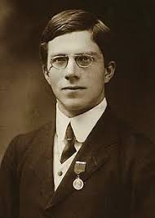
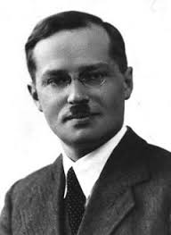
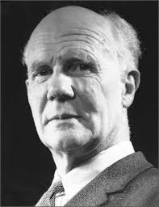
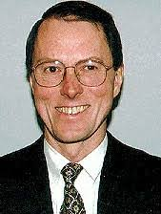
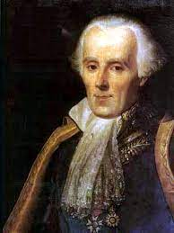
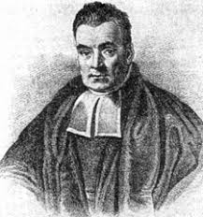
Statistical paradigms
Frequentists
Bayesians
Likelihoodists
RA Fisher
Significance tests
Jerzey Neyman / Egon Pearson
Null hypothesis significance tests
Leplace Thomas Bayes
Richard Royall
Probability of data given (assuming) hypothesis
Probability of hypothesis given (assuming) data

Slide 4
A statistical test
Hypothesis
A claim about some aspect of the process that might have given rise to data x=(x₁, x₂, ……, x_{n}), given in a model of that process
Assign probabilities of different outcomes x assuming the hypothesis is true
Distance function and its distribution
A function of the sample d(x)
A test statistic that reflects fit or misfit of data x with the hypothesis
Distribution of test statistic can be computed assuming the hypothesis is true
Test rule
Interpretative or methodological rule for inference
E.g., data (x) is evidence of a discrepancy δ from the hypothesis when d(x)≥ c, for some value of c
Probability that {d(x)≥ c} assuming the hypothesis is true can be calculated
c
Mayo DG. Statistical inference as severe testing. Cambridge: Cambridge University Press; 2018.

Slide 5
Definition of the p-value
Probability of observing the data or more extreme assuming the test hypothesis (often being the null hypothesis) is true
RA Fisher

Slide 6
Explain p-value in our example
Probability of observing 2 heads or more extreme (i.e., less than 2 heads) assuming the test hypothesis (i.e., the coin is fair) is true
Probability of observing 2 heads or less assuming the coin is fair

Slide 7
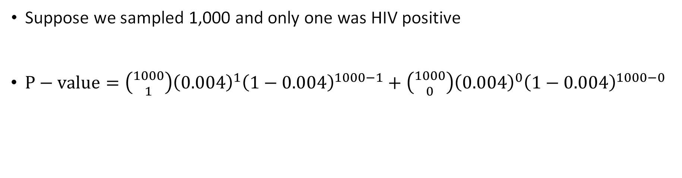
Another example of statistical test within context of HIV By Ken Rothman
Suppose we sampled 1,000 and only one was HIV positive
$P−value=\left({1000 \atop 1}\right){\left(0.004\right)}^{1}{\left(1−0.004\right)}^{1000−1}+\left({1000 \atop 0}\right){\left(0.004\right)}^{0}{\left(1−0.004\right)}^{1000−0}$
Probability of observing 1 HIV+ individual or more extreme (i.e., less) in the sample assuming that HIV prevalence in the population is 0.004
Rothman KJ, Greenland S, Lash TL. Modern epidemiology. Philadelphia: Wolters Kluwer Health/Lippincott Williams & Wilkins; 2008 Sep 20.

Slide 8
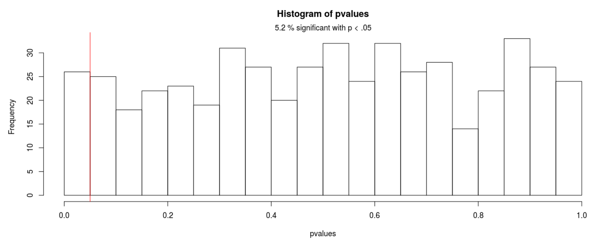
Explanation of distribution of the p-value if the null was true (fluoride has no effect on caries)
Uniform distribution

Slide 9
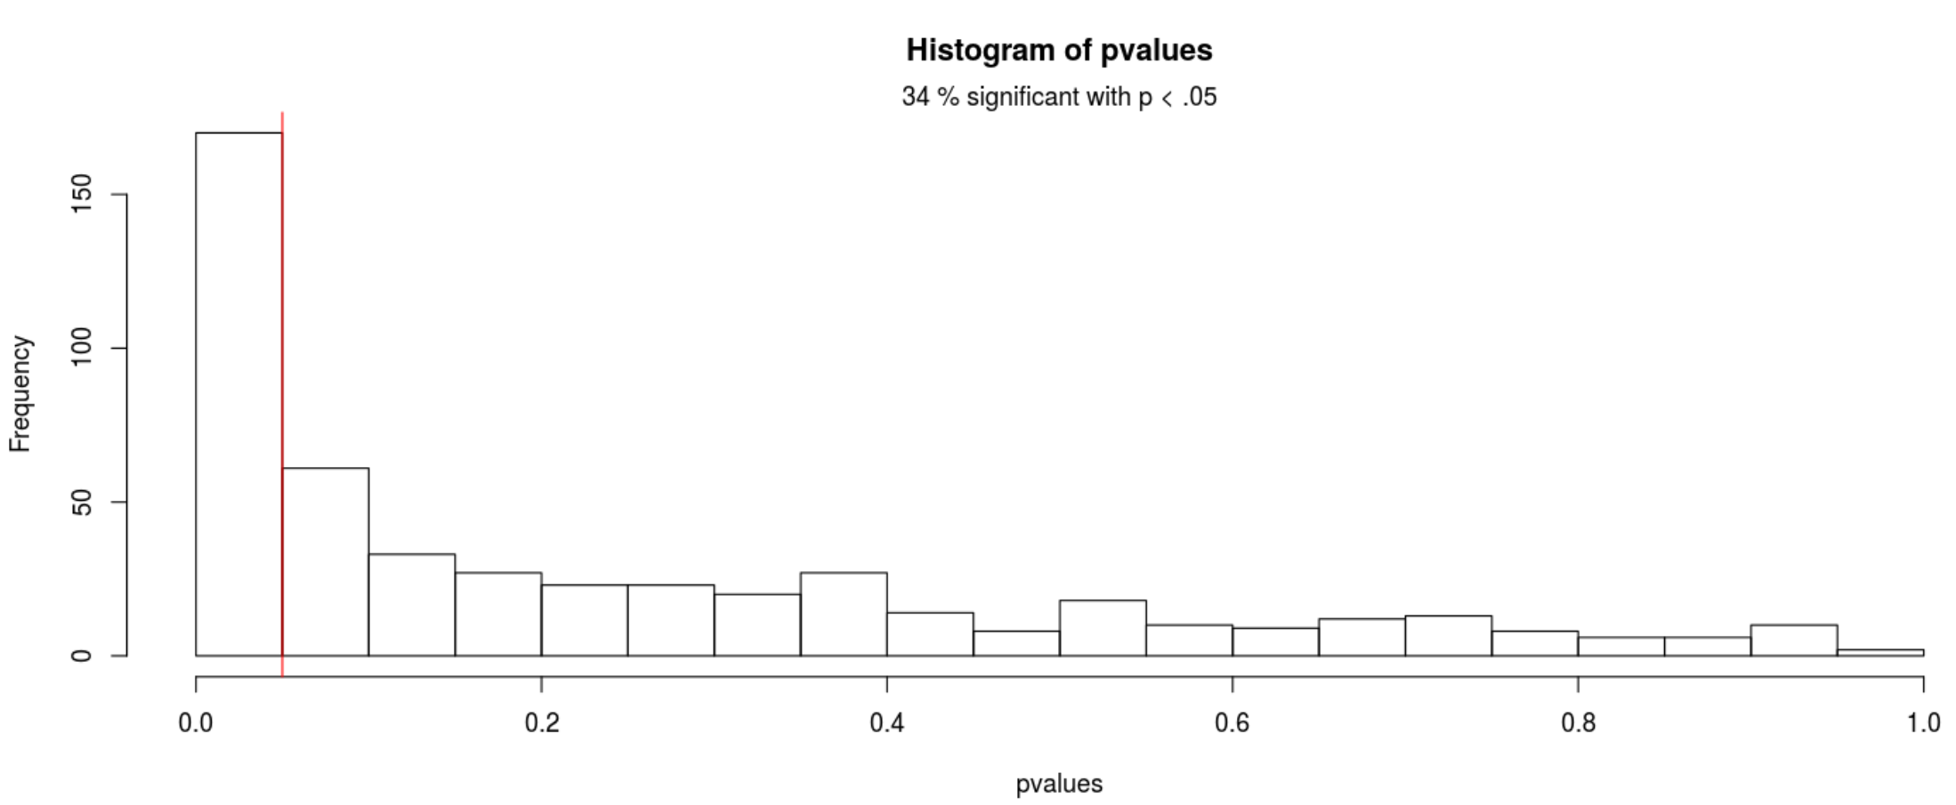
Explanation of distribution of the p-value if the null was false (fluoride has an effect on caries)
Skewed distribution to the right

Slide 10
Describe compatibility of p-value with the entire model
Assuming the entire model is true:
Test hypothesis (often being the null) is true
Auxiliary assumptions
Randomization/random sample
No confounding
No measurement error
No selection bias
No p-hacking
No hypothesizing after results are known (HARKING)
No fraud
Functional form is true
Range from 0-1
0=results impossible assuming the entire model is true
1=results perfectly compatible assuming the entire model is true
Null hypothesis significance testing (NHST)
< 0.05 (reject the model)
≥ 0.05 (failing to reject the model)

Slide 11
1st
2nd
3rd
4th
5th
6th
7th
8th
9th
10th
11th
12th
13th
14th
15th
16th
17th
18th
19th
20th
True mean
20
21
22
23
24
25
26
27
28
29
Inspired by examples in
Gelman A, Nolan D. Teaching statistics: A bag of tricks. Oxford University Press; 2017 May 4.

Slide 12
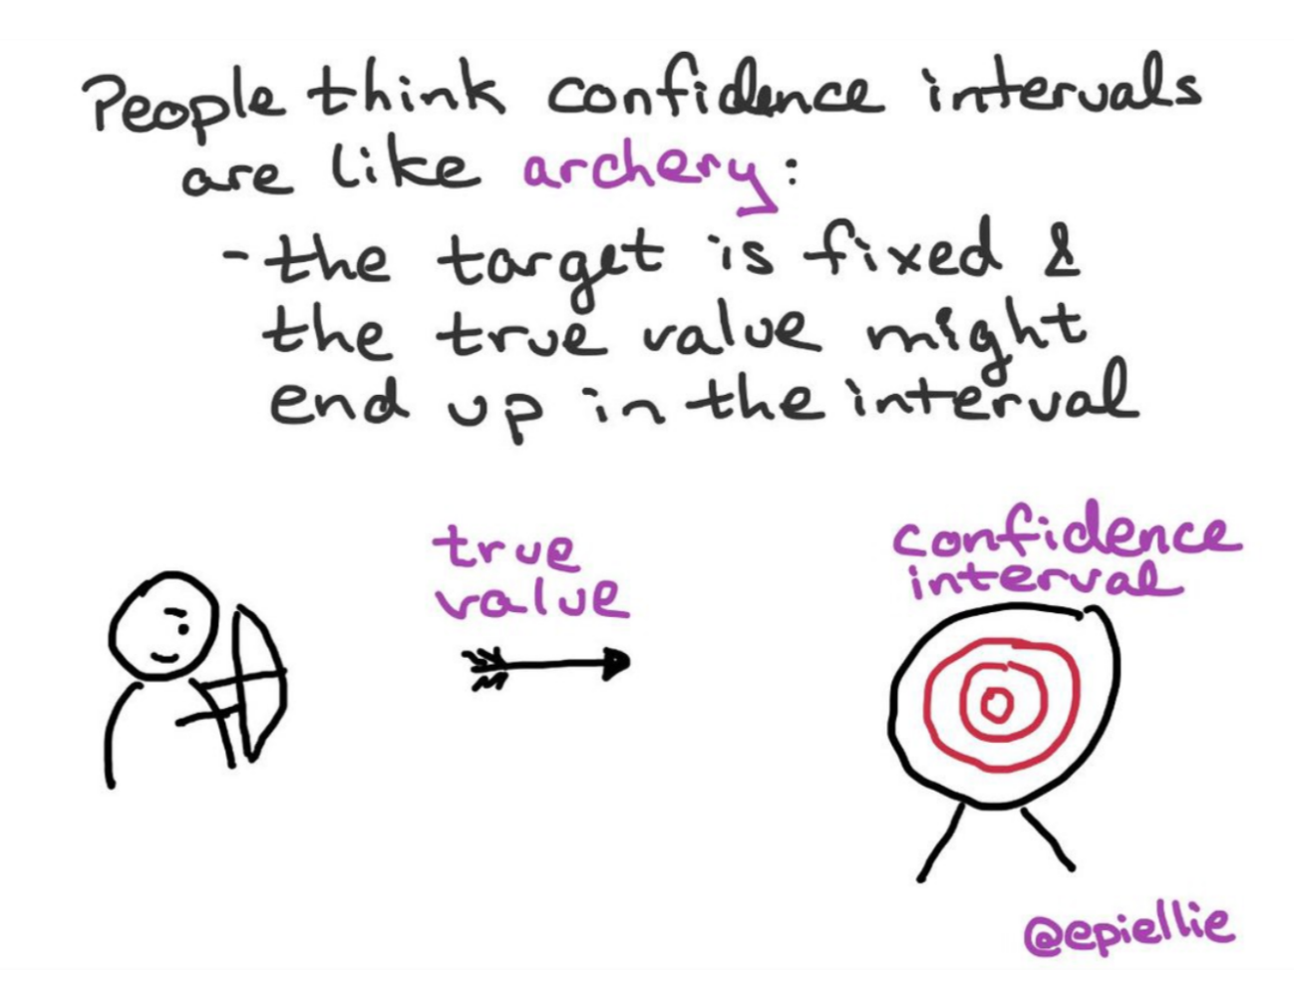
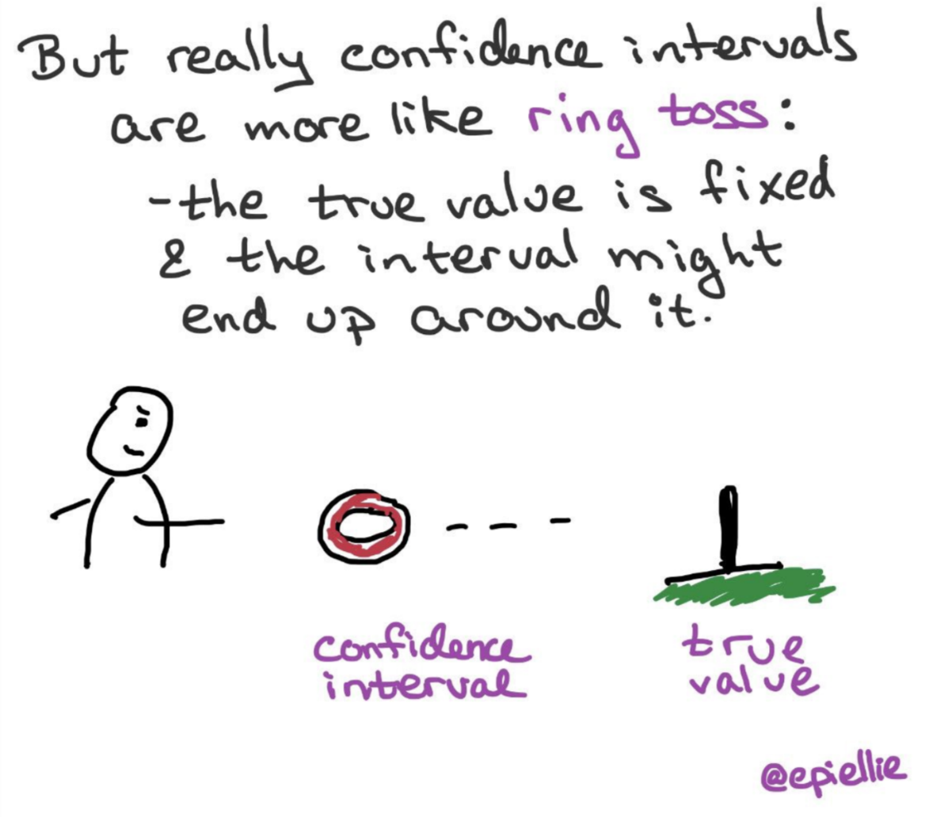
https://twitter.com/EpiEllie/status/1073385394580979712
https://medium.com/@EpiEllie

Slide 13
95% CI as an alternative (surrogate) significance tests
RR/OR the null value (value of no difference) is 1
RR= 1.3 (95% CI 1.1-1.4)
RR= 1.2 (95% CI 0.9-1.5)
RD the null value is 0
RD=2 (95% CI 1, 3)
RD=1 (95% CI -1, 2)
Observing a ratio of 1 is rare assuming the entire model is correct
Observing a ratio of 1 is common assuming the entire model is correct
Observing a difference of 0 is rare assuming the entire model is correct
Observing a difference of 0 is common assuming the entire model is correct

Slide 14
LECTURE LEARNING OUTCOMES OF EACH OF THE DIDACTIC SESSIONS
REFERENCE:
Chapters 1 and 2 in Sampling Design and Analysis 2nd edition
LECTURE LEARNING OUTCOMES:
Describe the types of sampling.
Describe the different sampling techniques.

Slide 15
Sampling

Slide 16
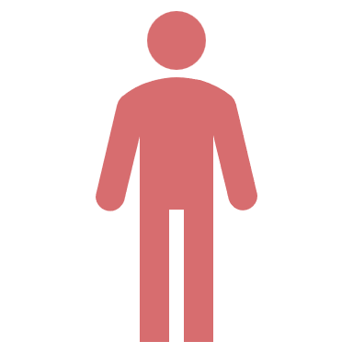

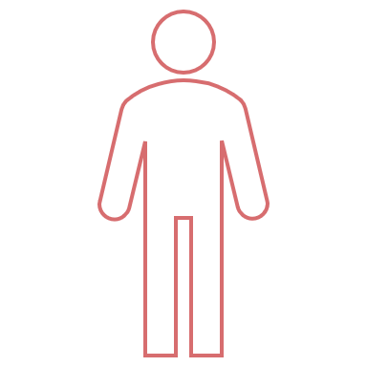
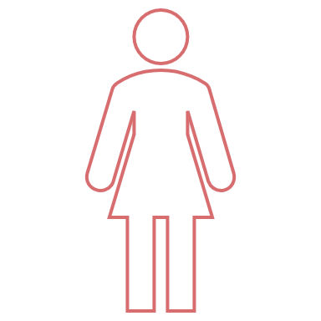
Sampling
What is it?
Why?
To reduce costs
To make study feasible
To save time

Slide 17
Target population
You want to make an inference to this population
Not part of your target population but included in your sampling frame (overcoverage)
Part of your target population but your sampling frame fails to capture (non-coverage error/undercoverage)
Sampling frame
You draw your sample from here (drawing sampling elements)
Your sample

Slide 18
Target population
You want to make an inference to this population
100% overlap between the two
Sampling frame
You draw your sample from here

Slide 19
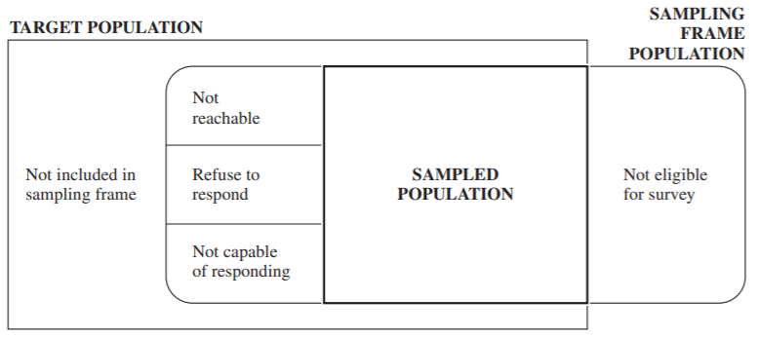
Lohr SL. Sampling: design and analysis. Nelson Education; 2009 Dec 9.

Slide 20
Definitions
Sample: subset of a population
Sampling element/observation unit: basic observation studies (individual) on which measurement is taken
Sampling unit: maybe individuals but also may be household from which elements (individuals) are sampled
Sampling frame: the list from which was draw our sample
Target population: the population we want to make an inference to
Coverage error: overlap between target population and sampling frame
Non-response error: error caused by selected participants who do not respond

Slide 21
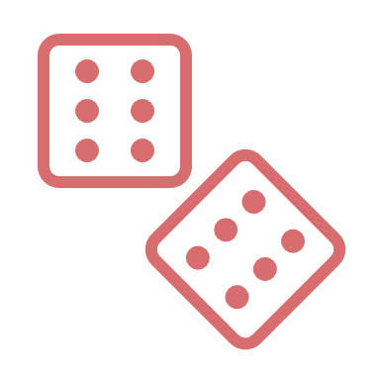
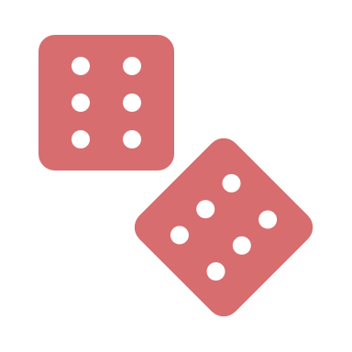
Sampling types
Probability sample
Probability of each element/unit getting selected is known (random)
Can yield a representative sample
E.g., assume KSAUH-HS dental students are a total of 200 and current D3 male students are 57 then probability of a male D3 student getting selected is 57/200=0.285
Non-probability sample
Probability of being selected is not known (based on human judgement)
Cannot yield a representative sample
E.g., number of D3 male students and/or total students is(are) not known. Ask faculty to try their best to select D3 students

Slide 22
Sampling types
Probability sampling
Simple random
Stratified
Cluster
Systematic random sample (technically a form of cluster sample)
Multistage (complex design)
Non-probability sampling
Purposive
Quota
Chunk
Snowball
Aday LA, Cornelius LJ. Designing and conducting health surveys: a comprehensive guide. John Wiley & Sons; 2006 Apr 14.

Slide 23
Non-probability sample

Slide 24
Non-probability sampling
Purposive (intentional)
Focus groups of D3 students (8-10 students) for getting opinions of dental students because you know them
Quota
Certain number of KSAUHS dental students (20)
Chunk
A group of individuals happen to be available at time of study
E.g., patients in waiting rooms to ask them why they were there
Aday LA, Cornelius LJ. Designing and conducting health surveys: a comprehensive guide. John Wiley & Sons; 2006 Apr 14.

Slide 25
Non-probability sampling
Snowball
Chain sampling (invite a person who then invite other people)
Useful for population that would hesitate to participate (or are very hard to find) if approached by investigation team instead of their inner circle (drug users/HIV patients/stigmatized individuals/homeless)
Useful even if not representative for in-depth investigation of
Difficult to find population
Expensive to find (drug users, homeless) population
If probability sample is infeasible or too expensive
Early stage of developing surveys (testing)
Hypothesis generation to be explored in a larger scale probability surveys (debatable)
Aday LA, Cornelius LJ. Designing and conducting health surveys: a comprehensive guide. John Wiley & Sons; 2006 Apr 14.

Slide 26
Probability sample

Slide 27
Simple random sample (SRS)
Each observation/element has the same known non-zero probability of being selected
Lottery or random number selection procedures (random number generator)
Software
Random number generator table
Every element in sampling frame assigned a unique identifying number
Numbers placed in a container and mixed together
Draw out numbers from container until required sample number is reached
Aday LA, Cornelius LJ. Designing and conducting health surveys: a comprehensive guide. John Wiley & Sons; 2006 Apr 14.

Slide 28
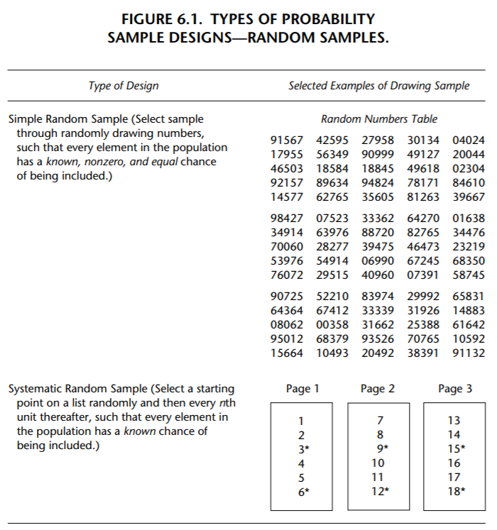
Aday LA, Cornelius LJ. Designing and conducting health surveys: a comprehensive guide. John Wiley & Sons; 2006 Apr 14.

Slide 29
Simple random sample (SRS)
Suppose we want to sample 20 KSAUHS dental students out of all dental students (200)
Sampling fraction/probability of selection=20/200=0.1
Each dental student at KSAUHS has a 0.1 probability of getting selected
Sampling fraction is not used in analysis of simple random sample but this just explains the idea
Aday LA, Cornelius LJ. Designing and conducting health surveys: a comprehensive guide. John Wiley & Sons; 2006 Apr 14.

Slide 30
Systematic random sample
Approximation to SRS
Start at a random point and then sample every i^{th} subject (specified interval)
Determination of starting point and interval depends on needed sample size
E.g., a population of 100 and we want to sample 20 the interval should be (100/20)=5 (sample every 5th element after randomly choosing a subject between ids 1 and 5.
Used if interest in representative sampling but not feasible to get a sampling frame list in advance (e.g., go to schools then take list of students in schools instead of directly a list of all students)
Aday LA, Cornelius LJ. Designing and conducting health surveys: a comprehensive guide. John Wiley & Sons; 2006 Apr 14.

Slide 31
Systematic random sample
A form of cluster sampling
Often used as lower stage of cluster sampling (to select secondary sampling units)
Efficiency depends:
If list is in a random order then same precision (variance) as SRS
If list is in decreasing or increasing order then more precise than SRS (implicit stratification that works with continuous variables)
If list has periodicity (even=males, odd=females) then less precise than SRS
Aday LA, Cornelius LJ. Designing and conducting health surveys: a comprehensive guide. John Wiley & Sons; 2006 Apr 14.

Slide 32
Aday LA, Cornelius LJ. Designing and conducting health surveys: a comprehensive guide. John Wiley & Sons; 2006 Apr 14.

Slide 33

Stratified sampling
When you want to make sure you have enough people in a certain category in your sample (e.g., enough males and females)
Some groups sampled at higher or lower rate (overrepresentation or underrepresentation)
Sampling frame divided into subgroups of interest/strata
(e.g., males and females)
Simple random sample (explicit stratification)
If few individuals are males in a population, a simple
random/systematic sample may not
include males
Aday LA, Cornelius LJ. Designing and conducting health surveys: a comprehensive guide. John Wiley & Sons; 2006 Apr 14.

Slide 34
Stratified sampling
Often decreases variance (improves precision) compared to
SRS (if variance among strata is lower than in total population)
Does not work with continuous variables
Use systematic sample with an ordered list (implicit stratification)
Categorize continuous variable
Aday LA, Cornelius LJ. Designing and conducting health surveys: a comprehensive guide. John Wiley & Sons; 2006 Apr 14.

Slide 35
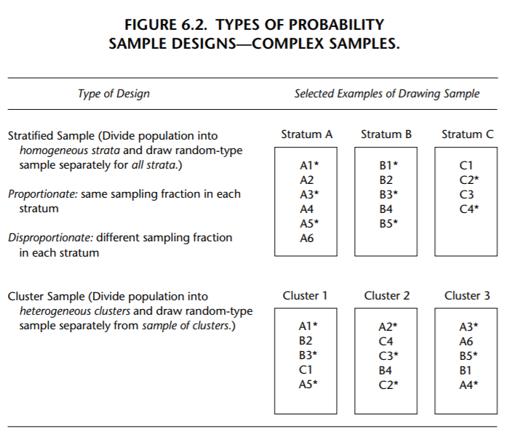
Aday LA, Cornelius LJ. Designing and conducting health surveys: a comprehensive guide. John Wiley & Sons; 2006 Apr 14.

Slide 36
Proportionate stratified sampling
Sample size required based on formula is 200
Subgroup/strata | Population number/size | Sampling fraction/probability of selection | Sample size/N is 200
Males | 100 | 100/(100+1000)=0.09 | 0.09*200=18
Females | 1000 | 1000/(100+1000)=0.91 | 0.91*200=182
No need to include sampling proportions in analysis
Each subgroup/strata reflects their proportion in the population (no over/under sampling)
Sampling fractions need to be reported for different groups
Aday LA, Cornelius LJ. Designing and conducting health surveys: a comprehensive guide. John Wiley & Sons; 2006 Apr 14.

Slide 37
Disproportionate stratified sampling
Sample size required based on formula is 200
Subgroup/strata | Population number/size | Sampling fraction/probability of selection | Sample size/N is 200 | Over or undersampling
Males | 100 | 50/100=0.5 | 50 | Was 0.09 and now is 0.5 so oversampled by 455.6%
Females | 1000 | 150/1000=0.15 | 150 | Was 0.91 and now is 0.15 so undersampled by -83.5%
Sampling proportions need to be accounted for in analysis
Each subgroup/strata reflects their proportion in the population (no over/under sampling)
Aday LA, Cornelius LJ. Designing and conducting health surveys: a comprehensive guide. John Wiley & Sons; 2006 Apr 14.

Slide 38
Cluster sampling
Maximize dispersion
Minimize costs
To sample people in geographical areas
Reduces travel costs
E.g., sample a city block that contains 70 houses and then include all houses or take a random sample of these 70 houses
E.g., If you want to sample school children
Take a random sample of school (which are clusters)
Then include all children in selected schools or take a random sample of children in each selected school
Aday LA, Cornelius LJ. Designing and conducting health surveys: a comprehensive guide. John Wiley & Sons; 2006 Apr 14.

Slide 39
Cluster sampling
More efficient design
Caveat is that people in a cluster are similar (share same characteristics)/homogeneous
People in different clusters are not similar
Between cluster heterogeneity is more than within cluster
This increases random error (variance) and needs to be accounted for in analysis otherwise
Calculating the variance as if this was a SRS would result in a smaller variance, increased precision/lower random error (type 1 error if NHST)
Design effects=$\frac{variance assuming simple random sample}{variance assuming cluster}$ (if 1 then no difference)
Aday LA, Cornelius LJ. Designing and conducting health surveys: a comprehensive guide. John Wiley & Sons; 2006 Apr 14.

Slide 40
Aday LA, Cornelius LJ. Designing and conducting health surveys: a comprehensive guide. John Wiley & Sons; 2006 Apr 14.

Slide 41
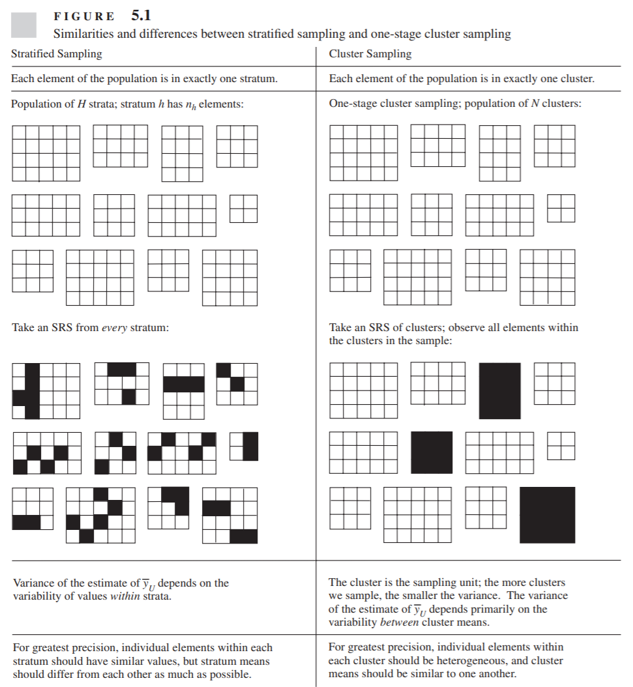
Lohr SL. Sampling: design and analysis. Nelson Education; 2009 Dec 9.

Slide 42
Criteria for evaluating sample design
Precision
Accuracy
Complexity
Efficiency
Aday LA, Cornelius LJ. Designing and conducting health surveys: a comprehensive guide. John Wiley & Sons; 2006 Apr 14.

Slide 43
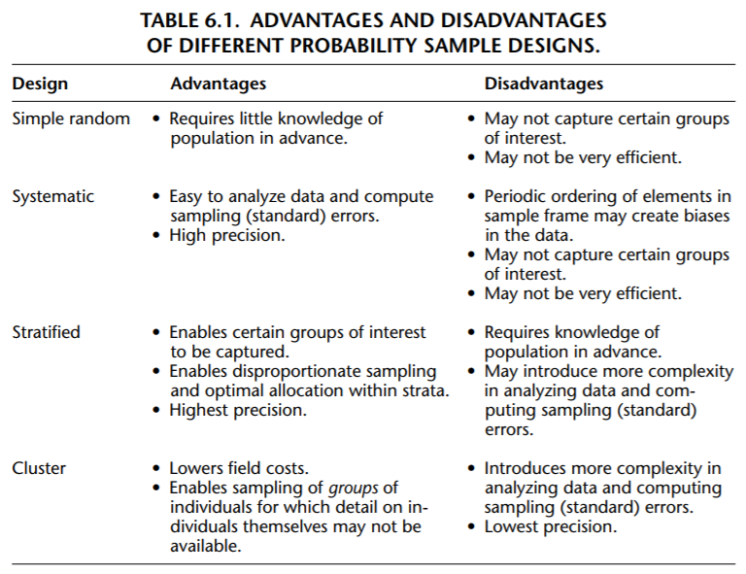
Aday LA, Cornelius LJ. Designing and conducting health surveys: a comprehensive guide. John Wiley & Sons; 2006 Apr 14.

Slide 44
Combined designs
Area probability sampling
Select geographic area that contain defined target population with known probability of selection
Data collected from households and individuals through in-person interviews (everyone in household or selected members)
Sampling with probability proportionate to size (PPS)
Combines SRS, systematic, cluster, and stratified
Sample is self-weighting (reflects distribution in target population)
Geographic information systems (GIS) can be used to facilitate design of this sampling
In Saudi (National address or National Address API)
Aday LA, Cornelius LJ. Designing and conducting health surveys: a comprehensive guide. John Wiley & Sons; 2006 Apr 14.

Slide 45
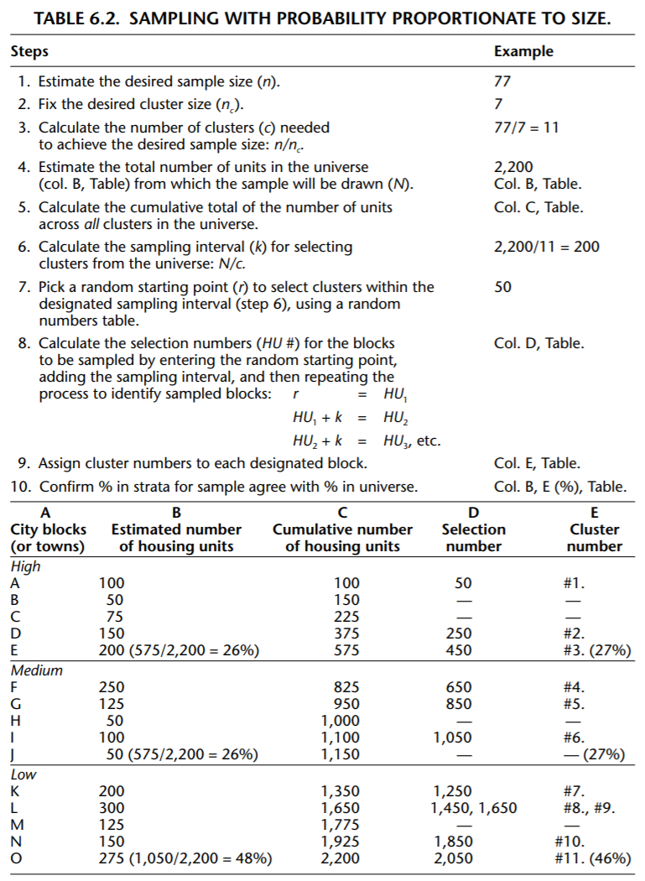
Aday LA, Cornelius LJ. Designing and conducting health surveys: a comprehensive guide. John Wiley & Sons; 2006 Apr 14.

Slide 46
Combined designs
Random digit dialing
Three approaches
List-assisted frames (numbers published in books/telephone directories)
Random digit dialing (randomly generated set of numbers)
Multiple frame
Aday LA, Cornelius LJ. Designing and conducting health surveys: a comprehensive guide. John Wiley & Sons; 2006 Apr 14.
https://www.citc.gov.sa/ar/reportsandstudies/studies/Documents/PublicIndividualReport2016V5_Ar.pdf

Slide 47



Mobile phone numbers and landline
125% out of total population in 2019 (Ministry of communications and Information Technology)
41,298,600 in 2019
30% in 2019 (Ministry of communications and Information Technology)
40% out of study participants aged 12-65 years in 2016 (Communications and Information Technology Commission)
5,377,980 in 2019
https://www.citc.gov.sa/ar/reportsandstudies/studies/Documents/PublicIndividualReport2016V5_Ar.pdf
https://www.mcit.gov.sa/ar/open-data
https://data.worldbank.org/indicator/IT.CEL.SETS?locations=SA

Slide 48
Combined designs
List sample
Identify list
Check completeness
Consider duplicate names, blank/incomplete information, dead people or moved out of area
Decide if respondents meet eligibility criteria
Calculate sampling fraction
Systematic sampling
Aday LA, Cornelius LJ. Designing and conducting health surveys: a comprehensive guide. John Wiley & Sons; 2006 Apr 14.

Slide 49
Combined designs
Internet sampling
Sometimes lists/sampling frames not available (non-probability snowball sampling)
Representativeness issues
Coverage issues (who is missing?)
https://www.citc.gov.sa/ar/reportsandstudies/studies/Documents/PublicIndividualReport2016V5_Ar.pdf
https://www.mcit.gov.sa/ar/open-data
https://data.worldbank.org/indicator/IT.CEL.SETS?locations=SA

Slide 50


Internet access
77% out of total population in 2017 (Ministry of communications and Information Technology)
94% out of study participants aged 12-65 years in 2016 (Communications and Information Technology Commission)
96% in 2019
93% in another source in 2020
Reasons for not using internet among study participants aged 12-65 years who did not use internet in past 6 months in 2016 (Communications and Information Technology Commission)
Do not know how to use it 51%
Do not know uses of internet 17%
Family does not allow its use 17%
Do not know internet 15%
Do not know how to subscribe 12%
Not available 10%
Cannot afford it 9%
https://www.citc.gov.sa/ar/reportsandstudies/studies/Documents/PublicIndividualReport2016V5_Ar.pdf
https://www.mcit.gov.sa/ar/open-data
https://data.worldbank.org/indicator/IT.CEL.SETS?locations=SA
https://datareportal.com/reports/digital-2020-saudi-arabia

Slide 51

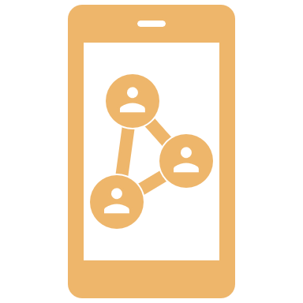
Smart phone ownership and social media within past month
88% out of study participants aged 12-65 years in 2016 (Communications and Information Technology Commission)
92% of internet users aged 16-64 in 2020
92% out of study participants aged 12-65 years in 2016 (Communications and Information Technology Commission)
72% out of internet user population in 2020
https://www.citc.gov.sa/ar/reportsandstudies/studies/Documents/PublicIndividualReport2016V5_Ar.pdf
https://www.mcit.gov.sa/ar/open-data
https://data.worldbank.org/indicator/IT.CEL.SETS?locations=SA

Slide 52






Social media within past month
76% in 2020
80% in 2016
71% in 2020
65% in 2020
48% in 2016
62% in 2020
57% in 2016
45% in 2020
58% in 2020
40% in 2016
https://datareportal.com/reports/digital-2020-saudi-arabia https://www.citc.gov.sa/ar/reportsandstudies/studies/Documents/PublicIndividualReport2016V5_Ar.pdf

Slide 53
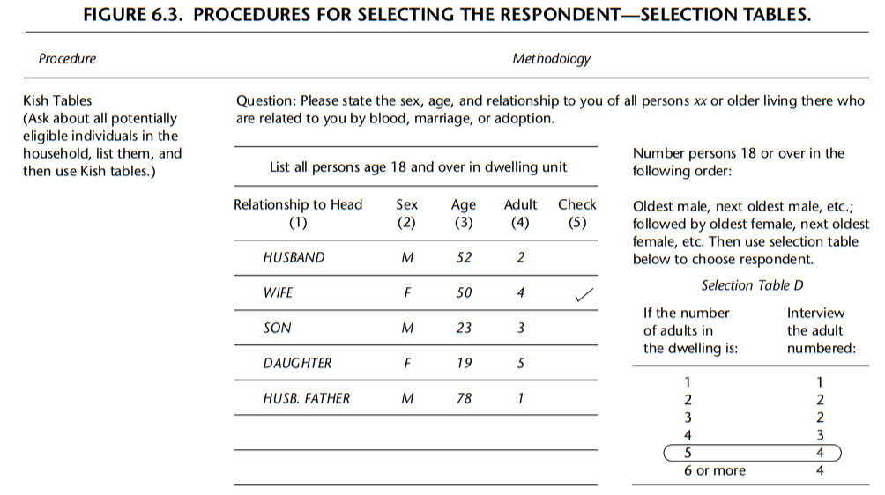
Sampling within households
Aday LA, Cornelius LJ. Designing and conducting health surveys: a comprehensive guide. John Wiley & Sons; 2006 Apr 14.

Slide 54
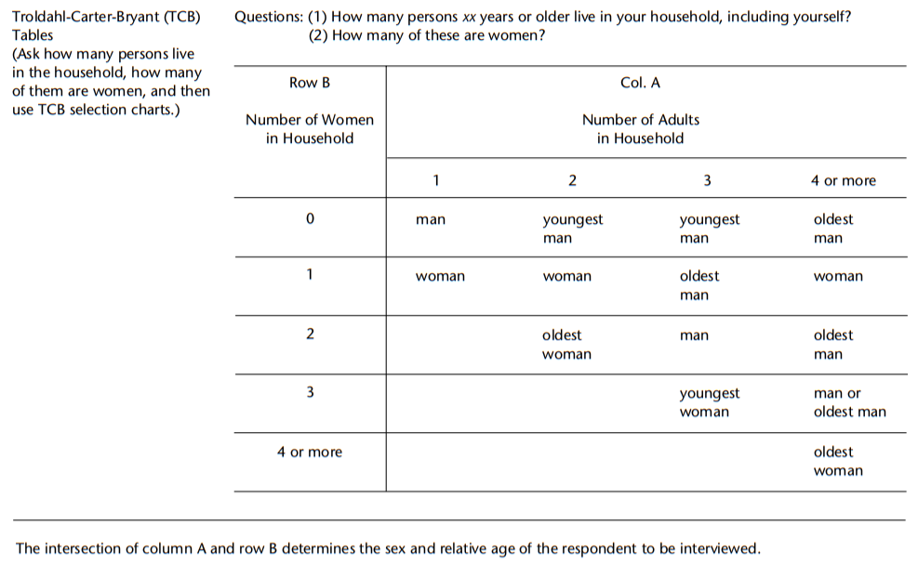
Sampling within households
Aday LA, Cornelius LJ. Designing and conducting health surveys: a comprehensive guide. John Wiley & Sons; 2006 Apr 14.

Slide 55
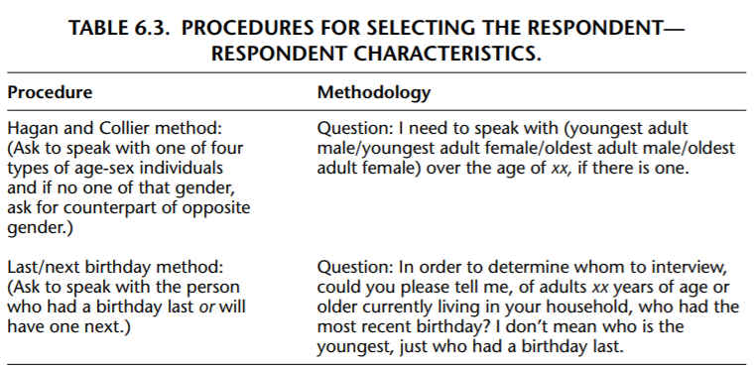
Sampling within households
Aday LA, Cornelius LJ. Designing and conducting health surveys: a comprehensive guide. John Wiley & Sons; 2006 Apr 14.

Slide 56
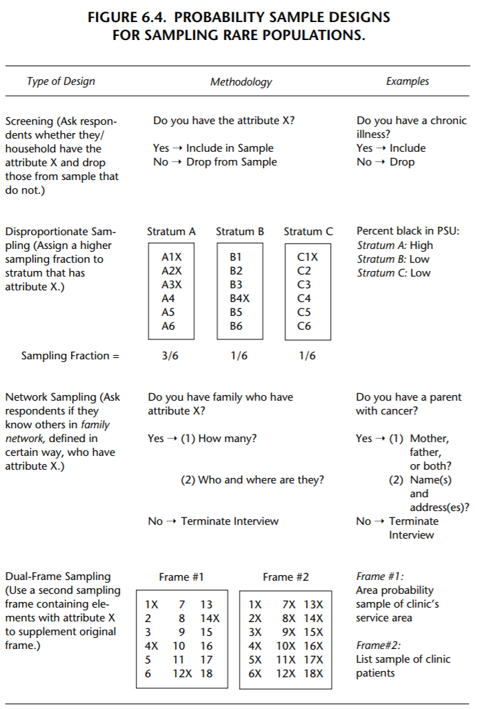
Special considerations
for special populations
Aday LA, Cornelius LJ. Designing and conducting health surveys: a comprehensive guide. John Wiley & Sons; 2006 Apr 14.

Slide 57
Coverage sampling for each mode
In-person
Household and then individual(s) within household (area probability sampling) staff go out and list all addresses of eligible housing units (business excluded)
No coverage problem in this case
Telephone
Some might not have telephones (coverage error)
Internet survey
Nonprobability sample (self-selection/sample bias)
Without internet (coverage error)
Goes to spam/junk
Email acquired may indicate invasion of privacy to participants
Self-administered usually uses a list
Coverage issue due to old not updated lists
Aday LA, Cornelius LJ. Designing and conducting health surveys: a comprehensive guide. John Wiley & Sons; 2006 Apr 14.

Slide 58
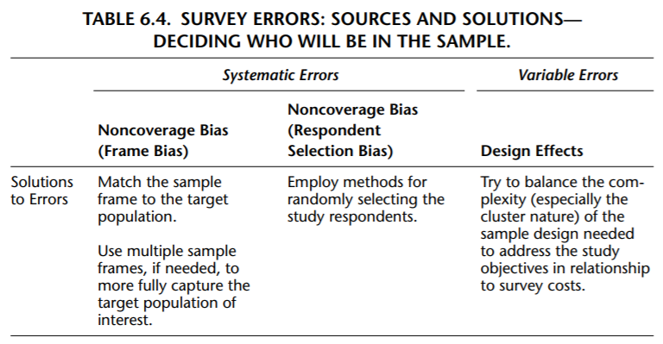
Aday LA, Cornelius LJ. Designing and conducting health surveys: a comprehensive guide. John Wiley & Sons; 2006 Apr 14.

Slide 59
Sources of error
Coverage error (systematic error)
Non-response error (systematic error)
Sampling error (random error)

Slide 60
Potential sampling frames
University staff (a list of all employees at KSAUHS)
Dental students in Saudi (a list of dental students in each university)
Dentists (Saudi Commission for Health Specialties/Saudi Dental Society/other specialty societies)
Saudi children (one stage or two stage cluster sample of schools)
STC/Mobily/Zain datasets or Ministry/Commission of Communication and Information Technology if possible (maybe not free)
Saudi post with national address?
Try Saudi Data and AI Authority
Try General Authority for Statistics

Slide 61


Sampling depends on study task
Descriptive
Representativeness is important
Causal
Debates about representativeness
Not required for internal validity
Some say required for external validity (which is tailored to your target population)
A new concept called target validity combines both internal and external and need representativeness of effect measure modifiers

Slide 62
Sample size calculations

Slide 63
Sample size calculation assumptions
Based on study task
Descriptive (based on sampling distribution)
Predictive (≥10 events per term/some say ≥4/ some say ≥50 as a rule of thumb/some say based on simulations)
Causal
Power (NHST)
Precision (estimation framework focus on width of CI instead of statistical significance)
Random sample
Useful with non-probability sampling?
Adjust for design effects
Cluster you would need more to reach same precision as SRS
Stratified you would need less to reach the same precision as SRS
Assume perfect participation?
Adjust for non-perfect participation
Finite population correction (assume infinite vs. finite population)

Slide 64
Sample size calculations
Descriptive and power calculation
https://select-statistics.co.uk/calculators/sample-size-calculator-population-proportion/
Precision
https://malcolmbarrett.shinyapps.io/precisely/

Slide 65
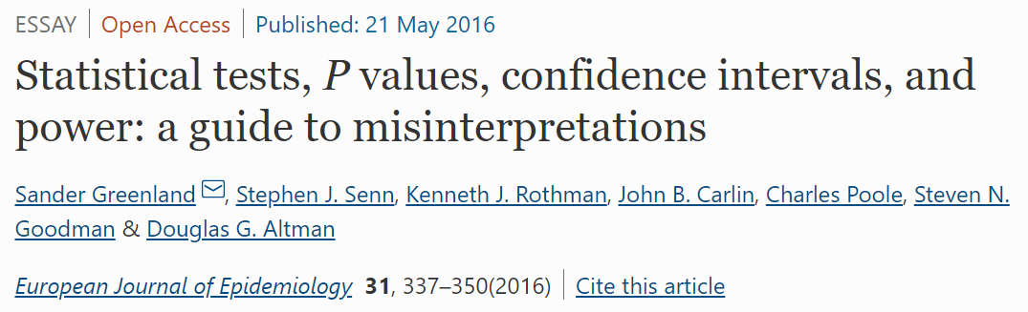
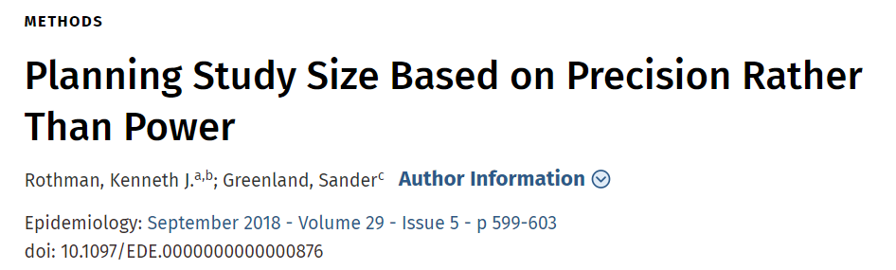
Sample size references

Slide 66

https://www.youtube.com/watch?v=Ltf6HjMeDjI&feature=youtu.be

Slide 67
Consultations
Research office at KAIMRC
Research office at University
School of Public Health
Free lancers
Try General Authority for Statistics?

Slide 68
Any Questions?
shihaybt@ksau-hs.edu.sa

